Slide 1

SUPERMARKET SALES
(Full Insights)
by
EMMANUEL VICTOR CHIBUNDU
TECH 1M DATA ANALYSIS BOOTCAMP

Slide 2
Project overview
Title: SUPERMARKET SALES INSIGHTS
Analytics Tools: MICROSOFT EXCEL, POWER BI
Github Link: https://github.com/EVhiktor60/SUPERMARKET-SALES-INSIGHTS.git
https://github.com/EVhiktor60/SUPERMARKET-SALES-INSIGHTS.git

Slide 3
PROJECT OUTLINES
Introduction
Data Exploration and Analysis
Statement of Problem and Objectives
Data Description
Solution Method
Insights drawn
Strategy Proposal and Conclusion

Slide 4
INTRODUCTION
Maximizing sales would mean to make the most sales revenue possible without the business taking loss. After all, businesses generally want to make as much revenue as possible with as little cost as possible, which can lead to greater profits.
One of the most prominent Techniques to enhance sales and revenues is the encouragement of repeated purchases via loyalty programs.
Loyalty programs sponsored by retailers, offer rewards, discounts, and other special incentives as a way to attract and retain customers

Slide 5

STATEMENT OF PROBLEM AND OBJECTIVES
STATEMENT OF PROBLEM
The supermarket is faced with problems arising from rapid increase in population, trading, income and education of inhabitants. With the dataset provided, data and information on the above mentioned can be created and known
OBJECTIVES
Use analytical tools to load data and analyze the data.
To establish the demography of different customers that patronize the supermarket.
To establish the effect of loyalty program on the sales.
To establish the products and branch that has recorded the most sales

Slide 6
DESCRIPTION OF DATA
This dataset was provided for the Work Experience Bootcamp, Group Project by TECH 1Milion, it provides details about a supermarket outlet across 3 different branches for 3 months sales period. The columns contained in the dataset include;
RowID - Serially generated row number
Invoice ID- Transaction ID
Branch- Supermarket Branch
City- Location of Customer
Customer type- Type of Customer (Member or Normal)
Gender- Gender of Customer
Product line- Product Description
Unit price- Price product is sold for by supermarket
Quantity- How many quantities purchased
Tax 5%- Tax at point of sale
Total- Price x Quantity (less tax)
Date- Date of Transaction
Time- Time of Transaction
Payment- Method of Payment
Cost_of_goods_sold- How much it cost the supermarket to acquire/produce the product
Gross margin percentage- % profit over cost
Gross income- Profit in money terms
Rating- Customer rating
Year in City- How long customer has been in City
Age- The age category of customers
ProdID- Unique ID for products sold

Slide 7
SOLUTION METHOD
Data Import
Creating a database and loading dataset onto the SQL environment for further action
Data Cleaning
Extraction of the date elements from the date columns and checking for missing values
Data Exploration And Analytics
Generating and visualization of insights from the dataset
Data Visualization
Design of a Dashboard to summarize the dataset

Slide 8

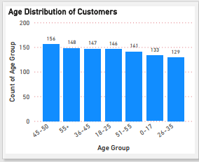

DATA EXPLORATION & ANALYTICS
AGE AND GENDER DISTRIBUTION OF CUSTOMERS
The Supermarket has experienced slightly more patronage from Female customers than the male customers
Customers within the age group of 40 – 50 , patronized the supermarket most.

Slide 9
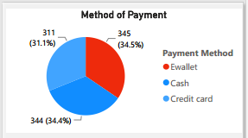
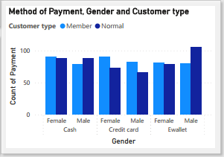
DATA EXPLORATION & ANALYTICS
PAYMENT METHOD AND CUSTOMER TYPE
Payment by E-wallet is the most used in the Supermarket.
Male customers without the loyalty card use the E-wallet method of payment

Slide 10
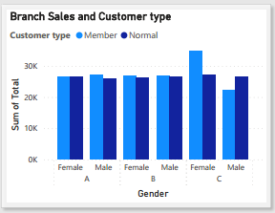
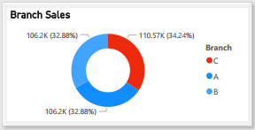
DATA EXPLORATION & ANALYTICS
BRANCH SALES AND CUSTOMER TYPE
The Supermarket branch located in branch C, has made the highest sales amongst other branches
Female customers with the loyalty card have patronized branch C, the most.

Slide 11
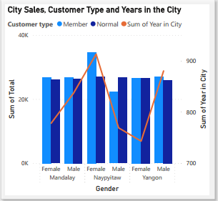
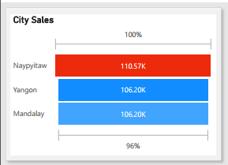
DATA EXPLORATION & ANALYTICS
CITY SALES AND CUSTOMER TYPE
Female customers with the loyalty card that have lived the highest number of years in Napytaw city, have patronised the Supermarket, the most .
Naypytaw city has recorded the highest sales for the Supermarket

Slide 12
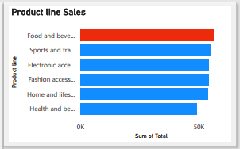

DATA EXPLORATION & ANALYTICS
PRODUCT LINE SALES AND CUSTOMER DISTRIBUTION
Customers that have the loyalty card patronize the Supermarket more than customers without the loyalty card
Food and Beverages records the highest sales in the Supermarket.

Slide 13
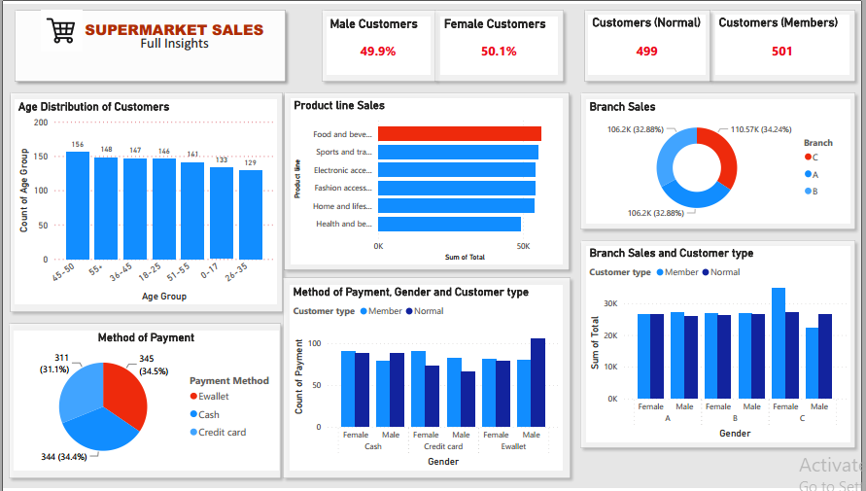
DATA VISUALIZATION

Slide 14

INSIGHTS DRAWN
Summary of Our Findings
>>The most common method of payment in the supermarket is E-wallet. >>Male Customers without loyalty card use the E-wallet method the most. >>Food and beverages product generates the most sales >>Branch C has generated the most sales amongst all other branches >>Female customers with the loyalty card use the branch C the most. >>Naypyitaw city has generated the most sales amongst other cities. >>Female customers with the loyalty card who have lived the longest in Naypyitaw, contribute the most sales in the city

Slide 15

STRATEGY PROPOSAL AND CONCLUSION
STATEGY PROPOSAL Having seen all these results from the analysis, I hereby propose;
>> The Supermarket should make available more product line especially Food and Beverages products, for customers who live in Naypytaw city. >> The Supermarket should also invest in the loyalty card for the normal customers, as this would encourage them (normal customers) to patronize the supermarket more, and retain them also. >> The Supermarket should as well look into promoting and investing more resources in the Branch C, as they hold the highest record of sales in the business. By investing more resources in Branch C, this would even attract more customers for the business. .

Slide 16



